Slide 1
“PROXEMICS”
Communication and Presentation Skills
Department of Computer Science
FAST NU Peshawar
Lecture by Ms. Maryam Ali Khan

Slide 2
PROXEMICS
How space and distance communicate
PERSONAL SPACE
TERRITRIAL SPACE
ACCOUSTIC SPACE
ARTIFACTS

Slide 3
1. PERSONAL SPACE
Distance maintained during interaction
What is the appropriate distance? It depends upon:
  Individual preferences
  Nature of our relationship
  Cultural norms
Personal space decreases as intimacy in relation increases

Slide 4
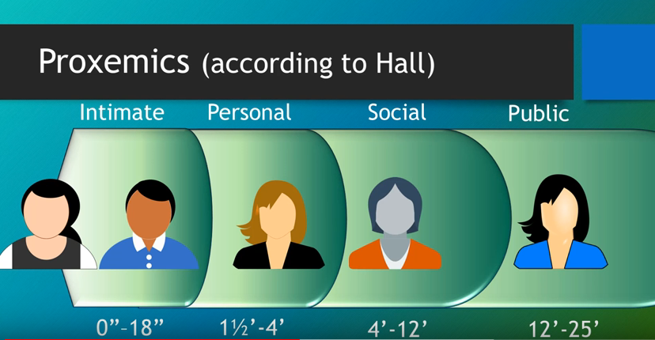

Slide 5
PERSONAL SPACE VARIATION ACCORDING TO US CULTURE
Intimate Distance
  Upto 18 inches
  Private conversations
Personal Distance
  18 inches to 4 feet
  Casual conversation
Social Distance
  4-12 feet
  Impersonal business such as a job interview
Public Distance
  Anything more than 12 feet

Slide 6
Americans become uncomfortable when outsiders violate the intimate distance
For example in a movie theatre, Americans tend to leave one or more seats empty between themselves and others they do not know. If a stranger sits right next to them in such a setting, they are likely to feel uncomfortable and may even move to another seat.

Slide 7
2. TERRITORIAL SPACE
Physical space over which we claim ownership
Annoyance over violation of territorial space
Territory is marked or claimed:
  With realization: locks, signs or fence
  Without realization: a chair usually used by a particular family member
Is territory marked by territorial markers only?
  No, not only territorial markers but also status
  Higher-status people claim larger and more prestigious territory
  Supervisor has largest and nicest office

Slide 8
3.ACOUSTIC SPACE
The area over which your voice can be comfortably heard
Competent communicators protect acoustic space by adjusting their volume to be heard their conversational partners and not over heard by others
Violation of acoustic space:
  Ringing of phone in library
  Talking in the library
  Making noise in hospitals
  Making noise if someone is asleep

Slide 9
5. ARTIFACTS
Objects used to adorn your property
People place objects not only because of their functions but also because of their aesthetic sense
Artifacts convey a message nonverbally:
  Chair and couch in a living room invite people to sit and talk
  Class room chairs arranged in a theatre style for discouraging conversations
  Managers office:
    Chairs facing the manager across the desk encourages formal conversation and signals status- “Let’s talk business, I am the boss and you are the employee.”

